Slide 1
Lecture 12:
Software Packages
Caffe / Torch / Theano / TensorFlow

Slide 2
Administrative
Milestones were due 2/17; looking at them this week
Assignment 3 due Wednesday 2/22
If you are using Terminal: BACK UP YOUR CODE!

Slide 3
Caffe http://caffe.berkeleyvision.org

Slide 4
Caffe Overview
From U.C. Berkeley
Written in C++
Has Python and MATLAB bindings
Good for training or finetuning feedforward models

Slide 5
Most important tip...
Don’t be afraid to read the code!

Slide 6
SoftmaxLossLayer
Caffe: Main classes
fc1
data
Blob: Stores data and derivatives (header source)
Layer: Transforms bottom blobs to top blobs (header + source)
Net: Many layers; computes gradients via forward / backward (header source)
Solver: Uses gradients to update weights (header source)
diffs
InnerProductLayer
W
data
X
data
y
data
diffs
diffs
diffs
DataLayer

Slide 7
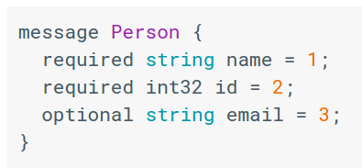
Caffe: Protocol Buffers
“Typed JSON” from Google
Define “message types” in .proto files
.proto file
https://developers.google.com/protocol-buffers/

Slide 8
Caffe: Protocol Buffers
“Typed JSON” from Google
Define “message types” in .proto files
Serialize instances to text files (.prototxt)
.proto file
.prototxt file
name: “John Doe”
id: 1234
email: “jdoe@example.com”
https://developers.google.com/protocol-buffers/

Slide 9
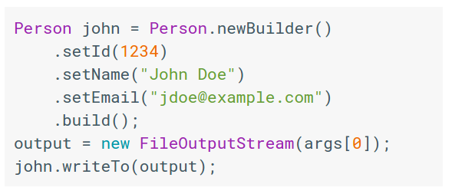
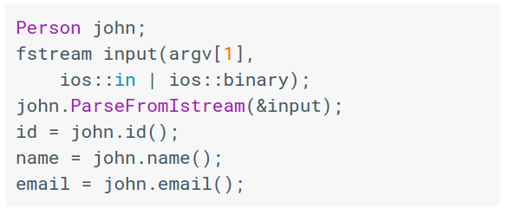
Caffe: Protocol Buffers
“Typed JSON” from Google
Define “message types” in .proto files
Serialize instances to text files (.prototxt)
Compile classes for different languages
.proto file
Java class
C++ class
.prototxt file
name: “John Doe”
id: 1234
email: “jdoe@example.com”
https://developers.google.com/protocol-buffers/

Slide 10
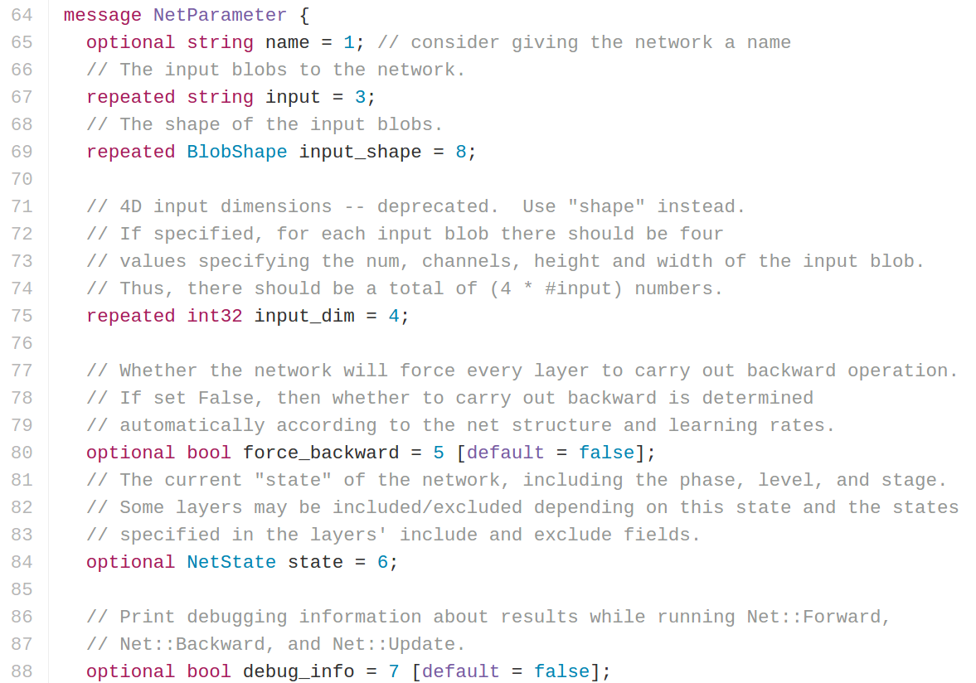
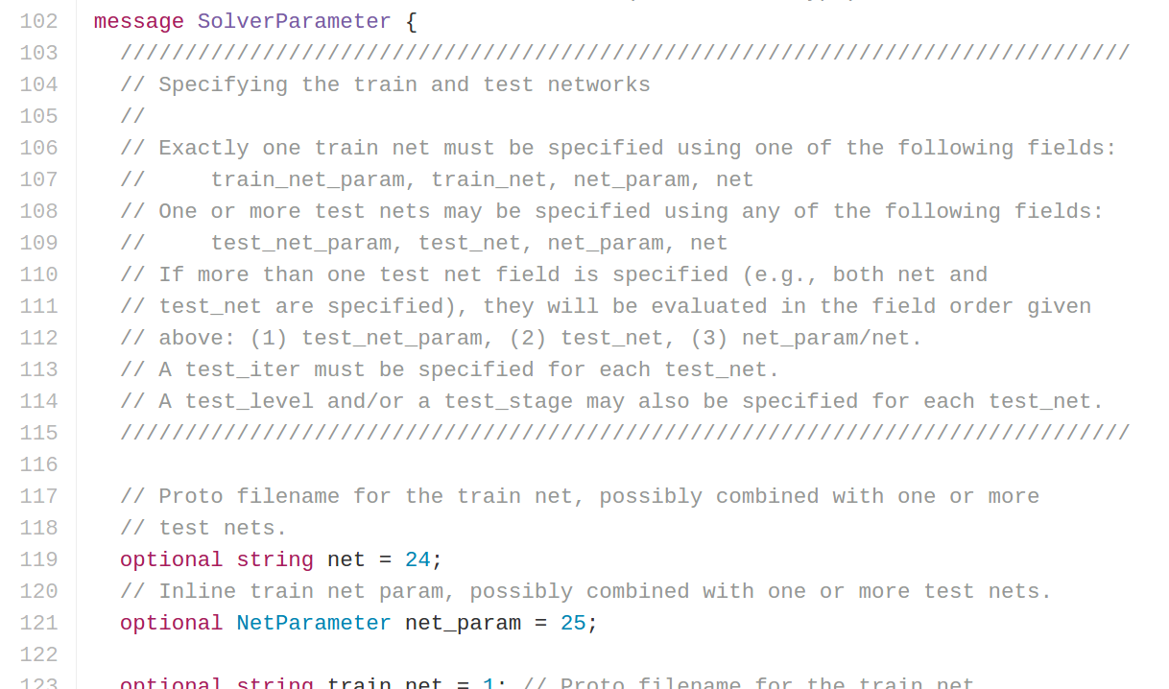
Caffe: Protocol Buffers
https://github.com/BVLC/caffe/blob/master/src/caffe/proto/caffe.proto
<- All Caffe proto types defined here, good documentation!

Slide 11
Caffe: Training / Finetuning
No need to write code!
Convert data (run a script)
Define net (edit prototxt)
Define solver (edit prototxt)
Train (with pretrained weights) (run a script)

Slide 12
Caffe Step 1: Convert Data
DataLayer reading from LMDB is the easiest
Create LMDB using convert_imageset
Need text file where each line is
“[path/to/image.jpeg] [label]”
Create HDF5 file yourself using h5py

Slide 13
Caffe Step 1: Convert Data
ImageDataLayer: Read from image files
WindowDataLayer: For detection
HDF5Layer: Read from HDF5 file
From memory, using Python interface
All of these are harder to use (except Python)

Slide 14
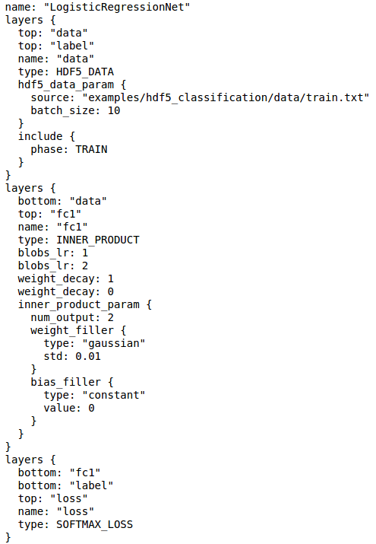
Caffe Step 2: Define Net

Slide 15
Caffe Step 2: Define Net
Layers and Blobs often have same name!

Slide 16
Caffe Step 2: Define Net
Layers and Blobs often have same name!
Learning rates (weight + bias)
Regularization (weight + bias)

Slide 17
Caffe Step 2: Define Net
Number of output classes
Layers and Blobs often have same name!
Learning rates (weight + bias)
Regularization (weight + bias)

Slide 18
Caffe Step 2: Define Net
Number of output classes
Layers and Blobs often have same name!
Set these to 0 to freeze a layer
Learning rates (weight + bias)
Regularization (weight + bias)

Slide 19
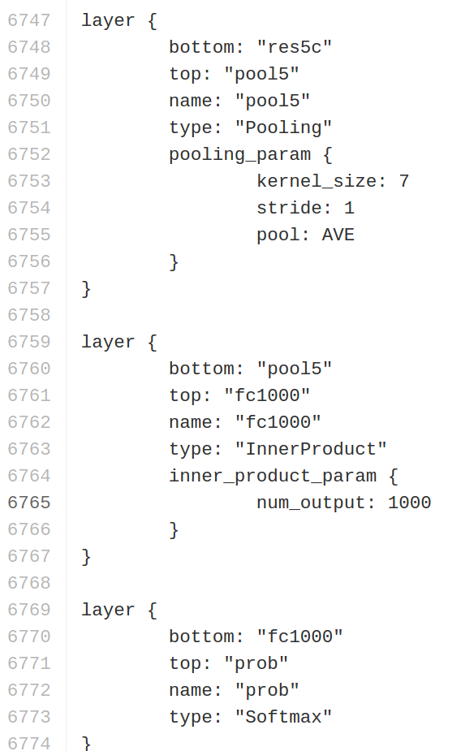
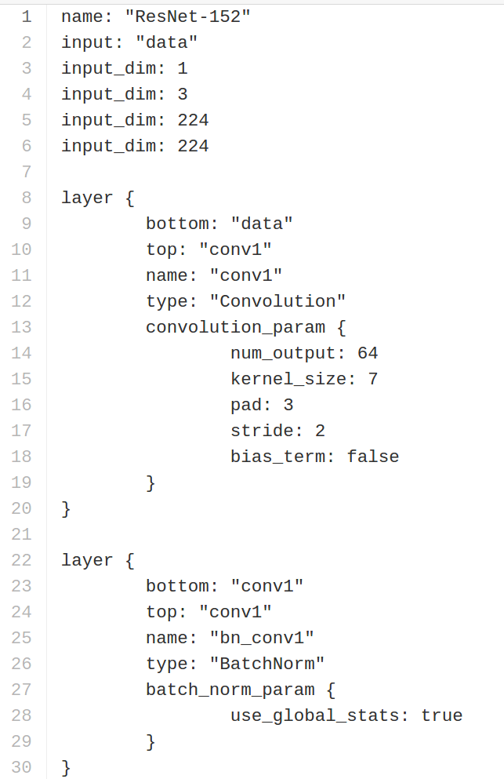
Caffe Step 2: Define Net
.prototxt can get ugly for big models
ResNet-152 prototxt is 6775 lines long!
Not “compositional”; can’t easily define a residual block and reuse
https://github.com/KaimingHe/deep-residual-networks/blob/master/prototxt/ResNet-152-deploy.prototxt

Slide 20
Caffe Step 2: Define Net (finetuning)
Original prototxt:
layer {
name: "fc7"
type: "InnerProduct"
inner_product_param {
num_output: 4096
}
}
[... ReLU, Dropout]
layer {
name: "fc8"
type: "InnerProduct"
inner_product_param {
num_output: 1000
}
}
Modified prototxt:
layer {
name: "fc7"
type: "InnerProduct"
inner_product_param {
num_output: 4096
}
}
[... ReLU, Dropout]
layer {
name: "my-fc8"
type: "InnerProduct"
inner_product_param {
num_output: 10
}
}
Pretrained weights:
“fc7.weight”: [values]
“fc7.bias”: [values]
“fc8.weight”: [values]
“fc8.bias”: [values]

Slide 21
Caffe Step 2: Define Net (finetuning)
Original prototxt:
layer {
name: "fc7"
type: "InnerProduct"
inner_product_param {
num_output: 4096
}
}
[... ReLU, Dropout]
layer {
name: "fc8"
type: "InnerProduct"
inner_product_param {
num_output: 1000
}
}
Same name: weights copied
Modified prototxt:
layer {
name: "fc7"
type: "InnerProduct"
inner_product_param {
num_output: 4096
}
}
[... ReLU, Dropout]
layer {
name: "my-fc8"
type: "InnerProduct"
inner_product_param {
num_output: 10
}
}
Pretrained weights:
“fc7.weight”: [values]
“fc7.bias”: [values]
“fc8.weight”: [values]
“fc8.bias”: [values]

Slide 22
Caffe Step 2: Define Net (finetuning)
Original prototxt:
layer {
name: "fc7"
type: "InnerProduct"
inner_product_param {
num_output: 4096
}
}
[... ReLU, Dropout]
layer {
name: "fc8"
type: "InnerProduct"
inner_product_param {
num_output: 1000
}
}
Same name: weights copied
Modified prototxt:
layer {
name: "fc7"
type: "InnerProduct"
inner_product_param {
num_output: 4096
}
}
[... ReLU, Dropout]
layer {
name: "my-fc8"
type: "InnerProduct"
inner_product_param {
num_output: 10
}
}
Pretrained weights:
“fc7.weight”: [values]
“fc7.bias”: [values]
“fc8.weight”: [values]
“fc8.bias”: [values]
Different name: weights reinitialized

Slide 23
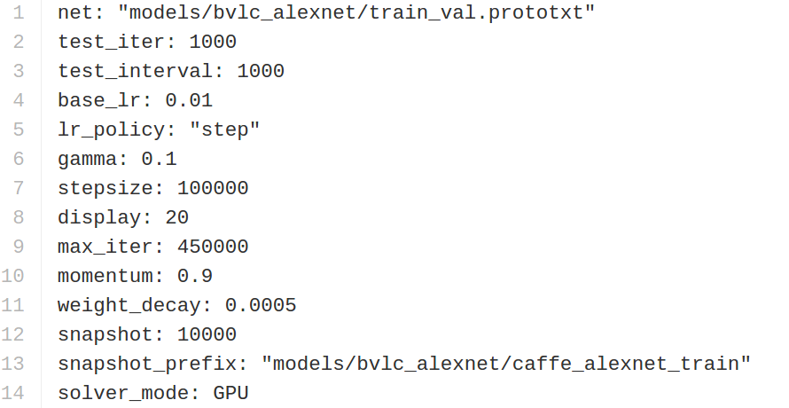
Caffe Step 3: Define Solver
Write a prototxt file defining a SolverParameter
If finetuning, copy existing solver.prototxt file
Change net to be your net
Change snapshot_prefix to your output
Reduce base learning rate (divide by 100)
Maybe change max_iter and snapshot

Slide 24
Caffe Step 4: Train!
./build/tools/caffe train \
-gpu 0 \
-model path/to/trainval.prototxt \
-solver path/to/solver.prototxt \
-weights path/to/pretrained_weights.caffemodel
https://github.com/BVLC/caffe/blob/master/tools/caffe.cpp

Slide 25
Caffe Step 4: Train!
./build/tools/caffe train \
-gpu 0 \
-model path/to/trainval.prototxt \
-solver path/to/solver.prototxt \
-weights path/to/pretrained_weights.caffemodel
-gpu -1 for CPU mode
https://github.com/BVLC/caffe/blob/master/tools/caffe.cpp

Slide 26
Caffe Step 4: Train!
./build/tools/caffe train \
-gpu 0 \
-model path/to/trainval.prototxt \
-solver path/to/solver.prototxt \
-weights path/to/pretrained_weights.caffemodel
-gpu all for multi-GPU data parallelism
https://github.com/BVLC/caffe/blob/master/tools/caffe.cpp

Slide 27
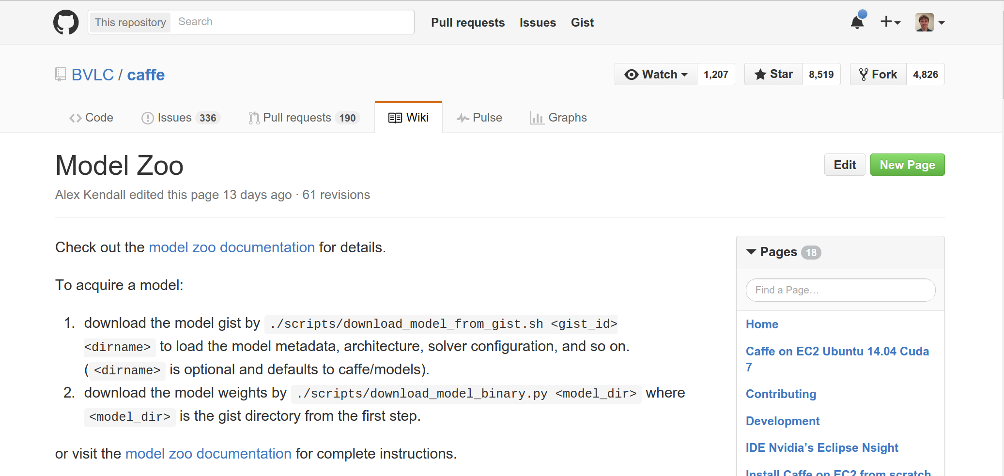
Caffe: Model Zoo
AlexNet, VGG, GoogLeNet, ResNet, plus others
https://github.com/BVLC/caffe/wiki/Model-Zoo

Slide 28
Caffe: Python Interface
Not much documentation…
Read the code! Two most important files:
caffe/python/caffe/_caffe.cpp:
Exports Blob, Layer, Net, and Solver classes
caffe/python/caffe/pycaffe.py
Adds extra methods to Net class

Slide 29
Caffe: Python Interface
Good for:
Interfacing with numpy
Extract features: Run net forward
Compute gradients: Run net backward (DeepDream, etc)
Define layers in Python with numpy (CPU only)

Slide 30
Caffe Pros / Cons
(+) Good for feedforward networks
(+) Good for finetuning existing networks
(+) Train models without writing any code!
(+) Python interface is pretty useful!
(-) Need to write C++ / CUDA for new GPU layers
(-) Not good for recurrent networks
(-) Cumbersome for big networks (GoogLeNet, ResNet)

Slide 31
Torch http://torch.ch

Slide 32
Torch Overview
From NYU + IDIAP
Written in C and Lua
Used a lot a Facebook, DeepMind

Slide 33
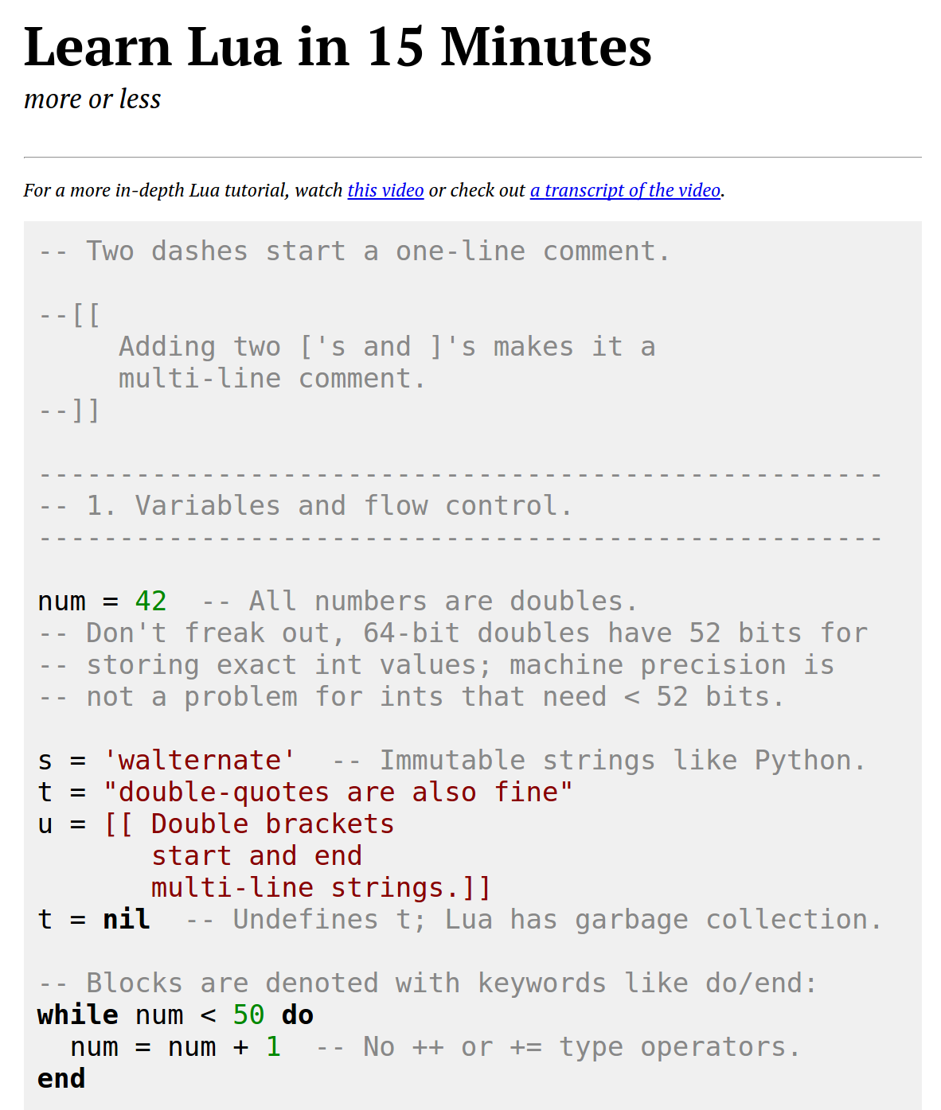
Torch: Lua
High level scripting language, easy to interface with C
Similar to Javascript:
One data structure: table == JS object
Prototypical inheritance metatable == JS prototype
First-class functions
Some gotchas:
1-indexed =(
Variables global by default =(
Small standard library
http://tylerneylon.com/a/learn-lua/

Slide 34
Torch: Tensors
Torch tensors are just like numpy arrays

Slide 35
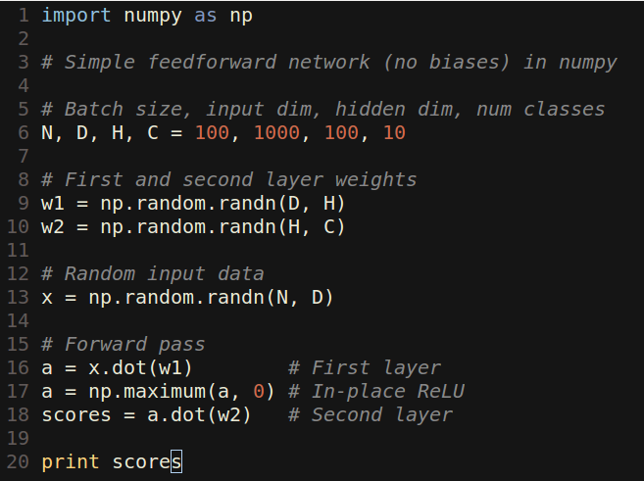
Torch: Tensors
Torch tensors are just like numpy arrays

Slide 36
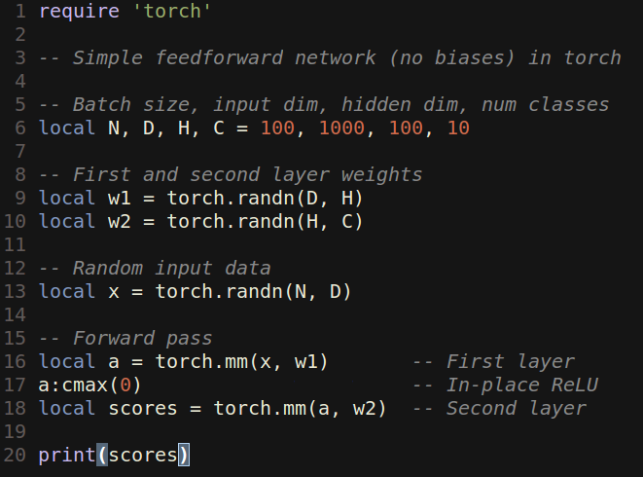
Torch: Tensors
Torch tensors are just like numpy arrays

Slide 37
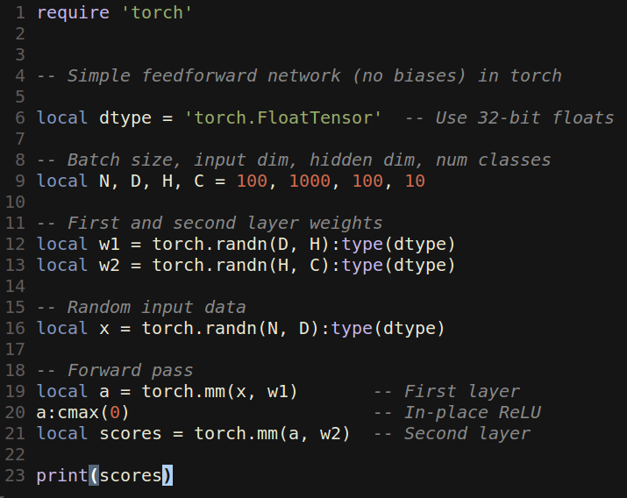
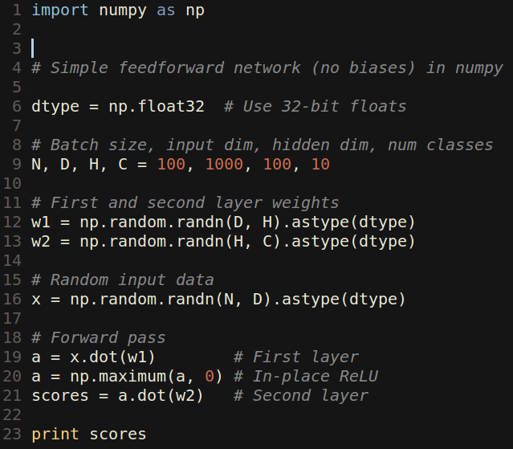
Torch: Tensors
Like numpy, can easily change data type:

Slide 38
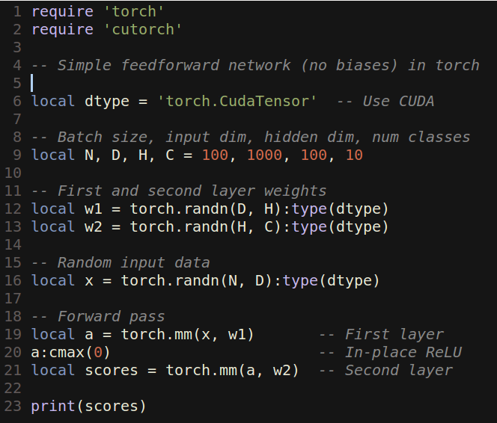
Torch: Tensors
Unlike numpy, GPU is just a datatype away:

Slide 39
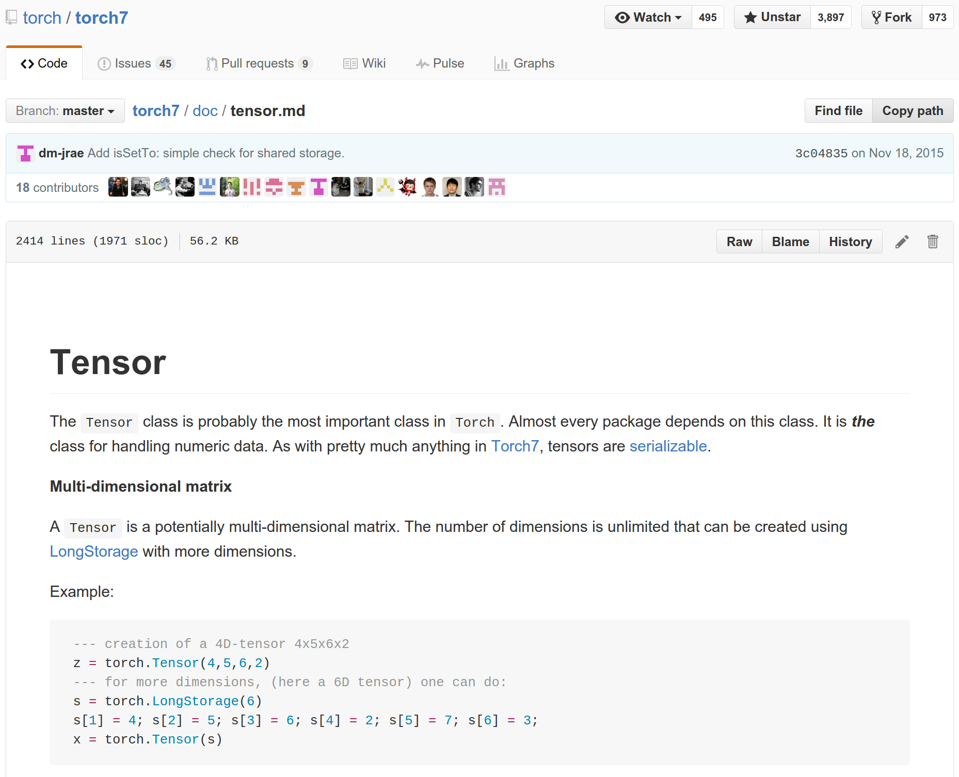
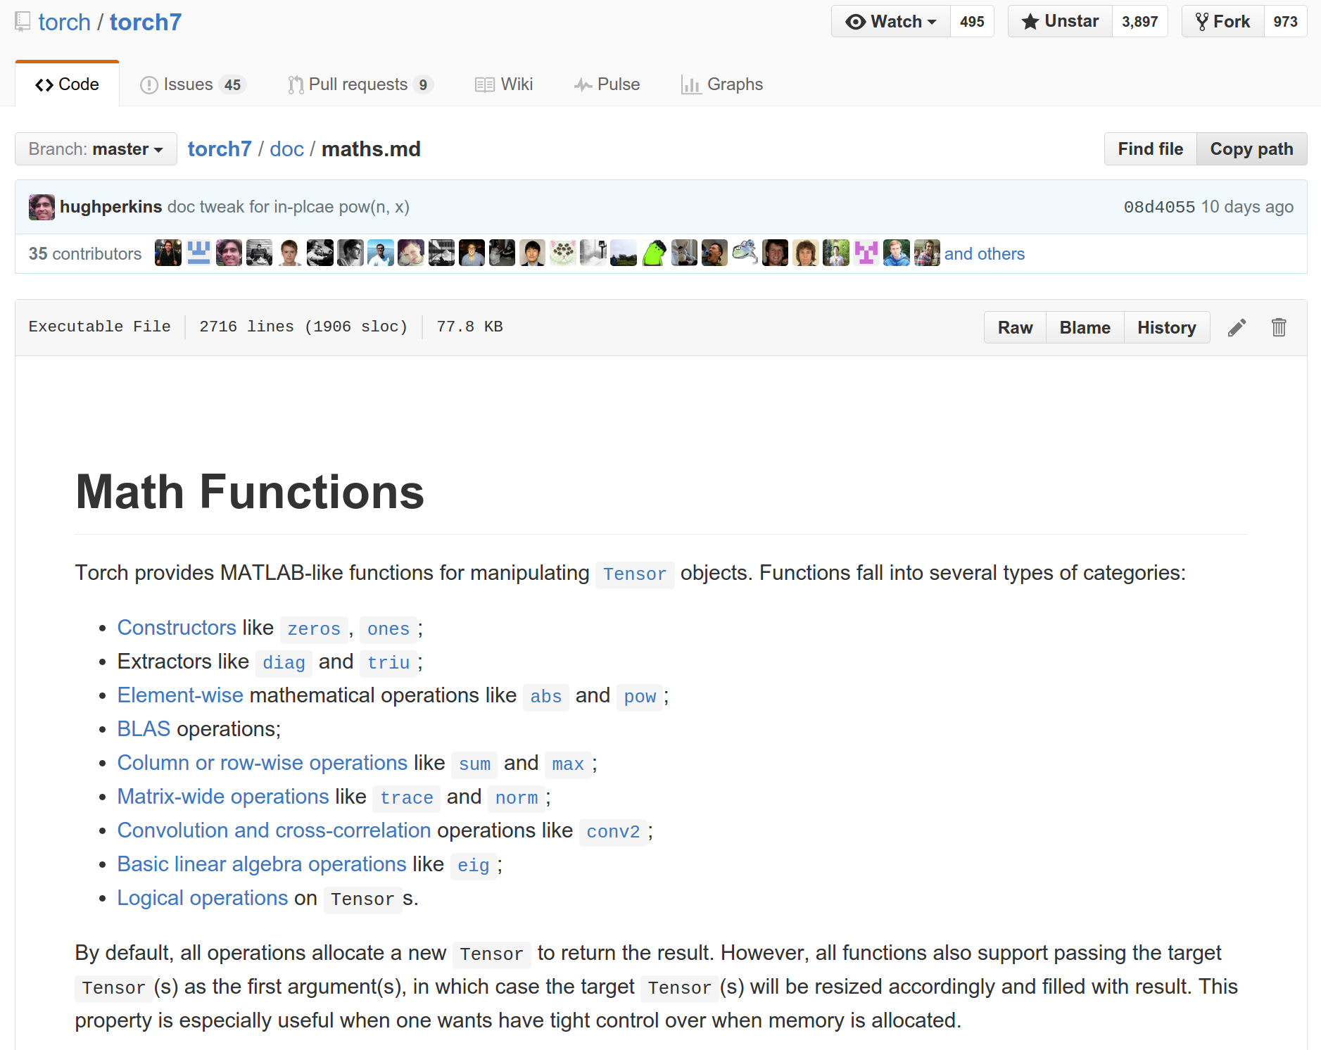
Torch: Tensors
Documentation on GitHub:
https://github.com/torch/torch7/blob/master/doc/tensor.md
https://github.com/torch/torch7/blob/master/doc/maths.md

Slide 40
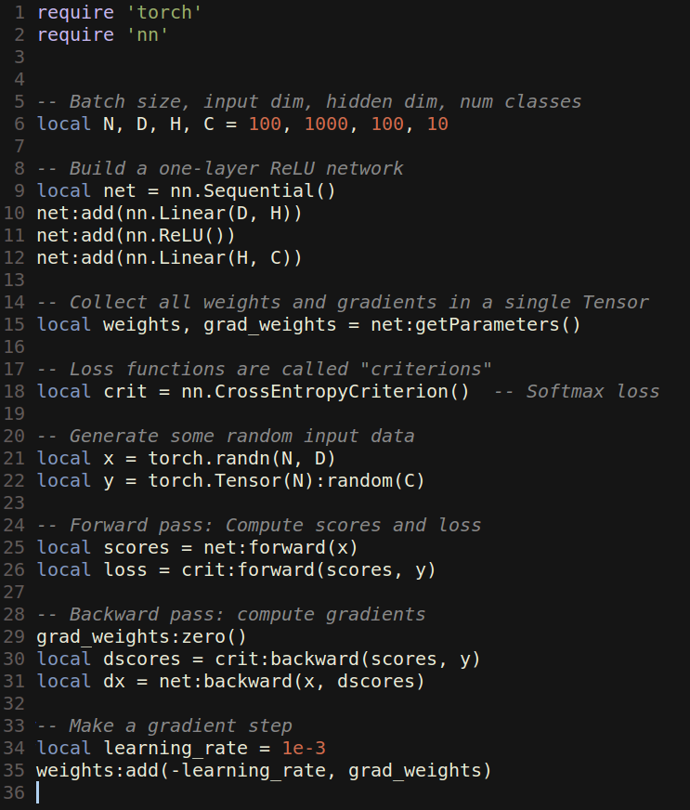
Torch: nn
nn module lets you easily build and train neural nets

Slide 41
Torch: nn
nn module lets you easily build and train neural nets
Build a two-layer ReLU net

Slide 42
Torch: nn
nn module lets you easily build and train neural nets
Get weights and gradient for entire network

Slide 43
Torch: nn
nn module lets you easily build and train neural nets
Use a softmax loss function

Slide 44
Torch: nn
nn module lets you easily build and train neural nets
Generate random data

Slide 45
Torch: nn
nn module lets you easily build and train neural nets
Forward pass: compute scores and loss

Slide 46
Torch: nn
nn module lets you easily build and train neural nets
Backward pass: Compute gradients. Remember to set weight gradients to zero!

Slide 47
Torch: nn
nn module lets you easily build and train neural nets
Update: Make a gradient descent step

Slide 48
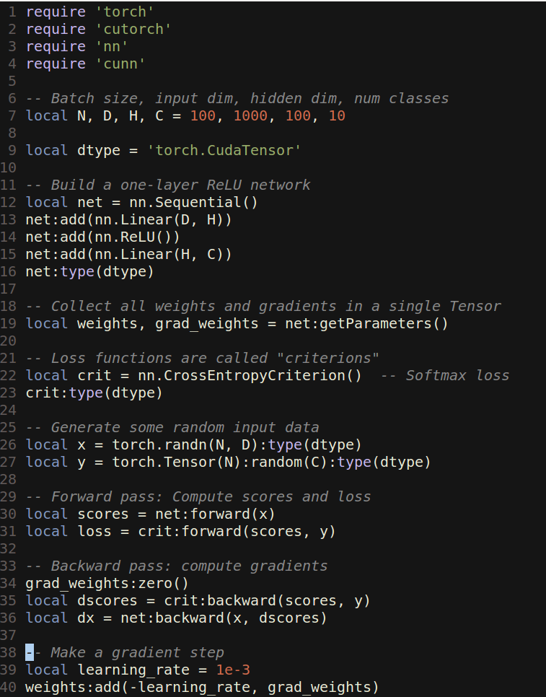
Torch: cunn
Running on GPU is easy:

Slide 49
Torch: cunn
Running on GPU is easy:
Import a few new packages

Slide 50
Torch: cunn
Running on GPU is easy:
Import a few new packages
Cast network and criterion

Slide 51
Torch: cunn
Running on GPU is easy:
Import a few new packages
Cast network and criterion
Cast data and labels

Slide 52
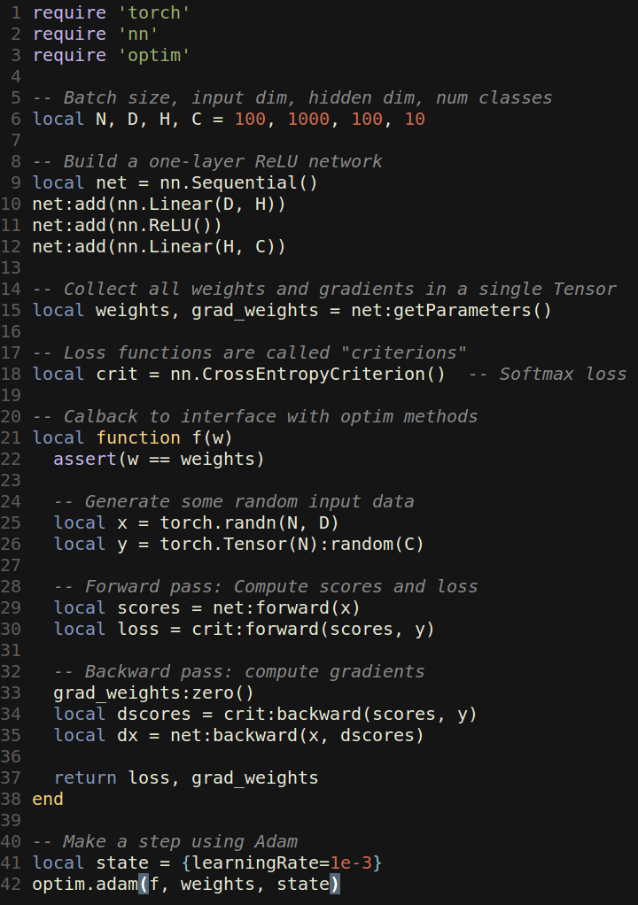
Torch: optim
optim package implements different update rules: momentum, Adam, etc

Slide 53
Torch: optim
optim package implements different update rules: momentum, Adam, etc
Import optim package

Slide 54
Torch: optim
optim package implements different update rules: momentum, Adam, etc
Import optim package
Write a callback function that returns loss and gradients

Slide 55
Torch: optim
optim package implements different update rules: momentum, Adam, etc
Import optim package
Write a callback function that returns loss and gradients
state variable holds hyperparameters, cached values, etc; pass it to adam

Slide 56
Torch: Modules
Caffe has Nets and Layers; Torch just has Modules

Slide 57
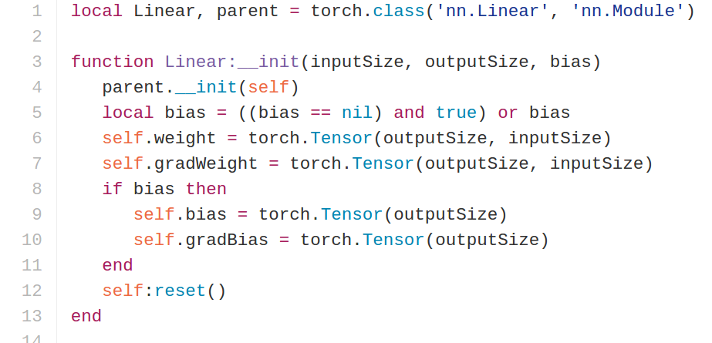
Torch: Modules
Caffe has Nets and Layers; Torch just has Modules
Modules are classes written in Lua; easy to read and write
Forward / backward written in Lua using Tensor methods
Same code runs on CPU / GPU
https://github.com/torch/nn/blob/master/Linear.lua

Slide 58
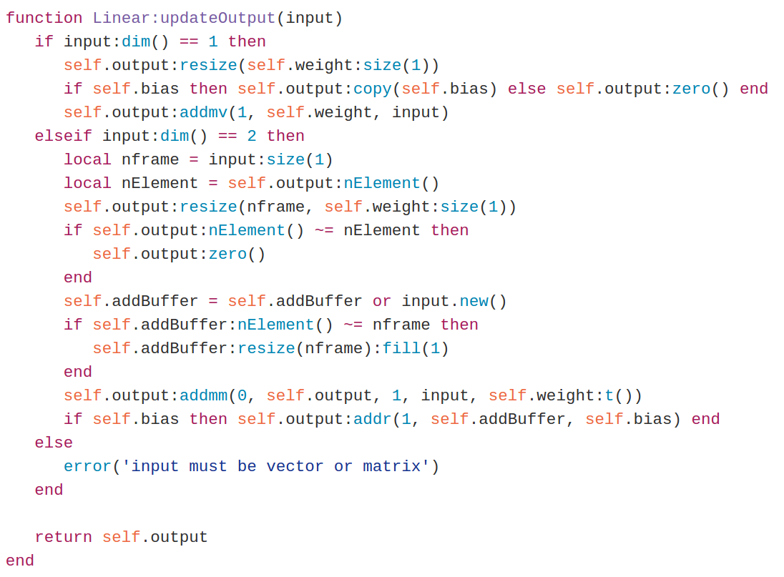
Torch: Modules
Caffe has Nets and Layers; Torch just has Modules
Modules are classes written in Lua; easy to read and write
updateOutput: Forward pass; compute output
https://github.com/torch/nn/blob/master/Linear.lua

Slide 59
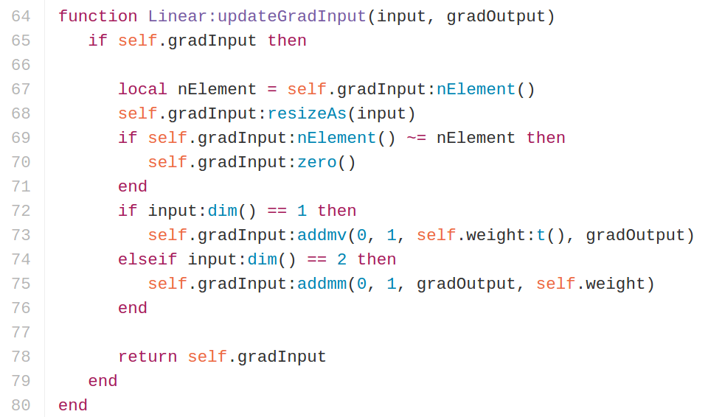
Torch: Modules
Caffe has Nets and Layers; Torch just has Modules
Modules are classes written in Lua; easy to read and write
updateGradInput: Backward; compute gradient of input
https://github.com/torch/nn/blob/master/Linear.lua

Slide 60
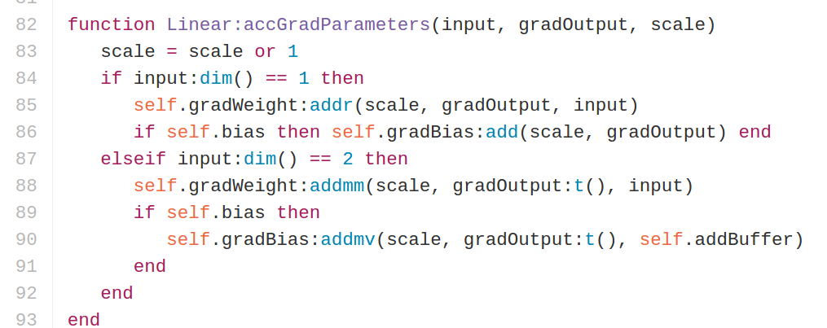
Torch: Modules
Caffe has Nets and Layers; Torch just has Modules
Modules are classes written in Lua; easy to read and write
accGradParameters: Backward; compute gradient of weights
https://github.com/torch/nn/blob/master/Linear.lua

Slide 61
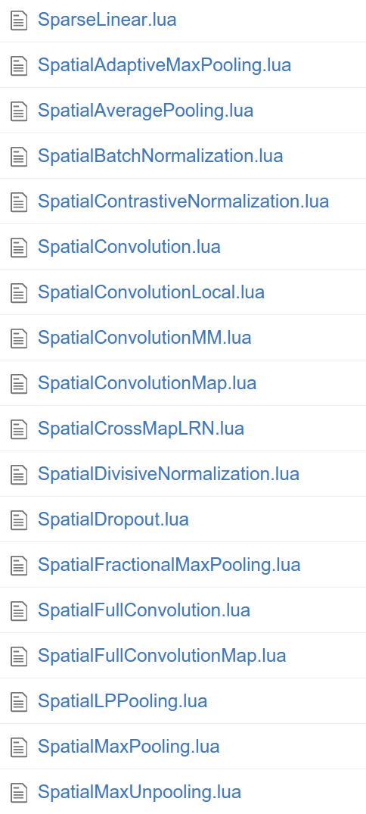
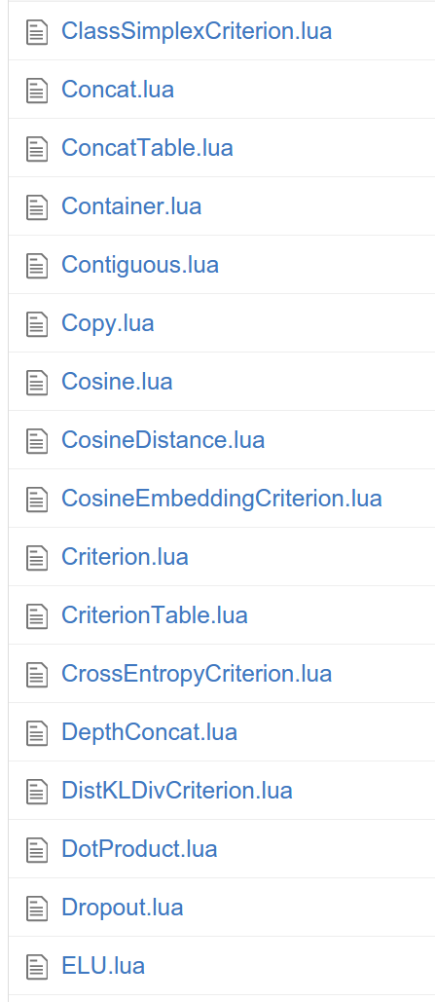
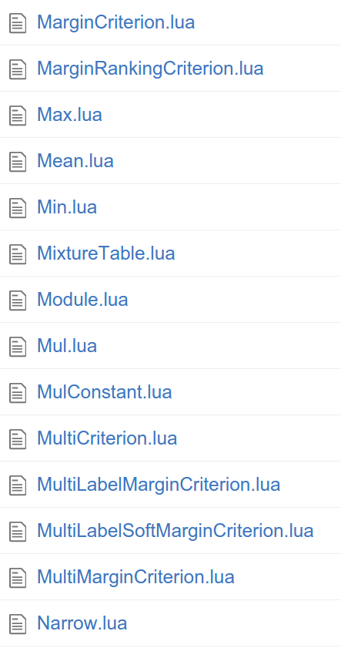
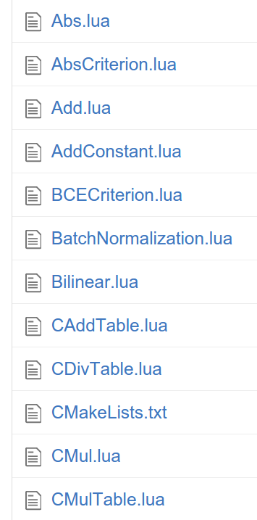
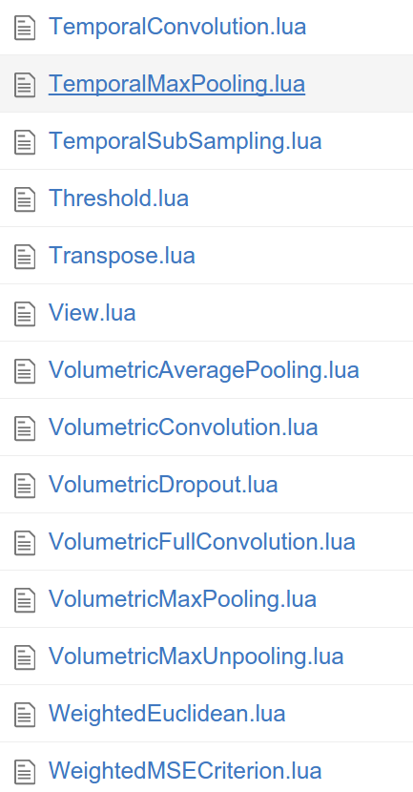
Torch: Modules
Tons of built-in modules and loss functions
https://github.com/torch/nn

Slide 62
Torch: Modules
Added 2/19/2016
Added 2/16/2016
Tons of built-in modules and loss functions
New ones all the time:
https://github.com/torch/nn

Slide 63
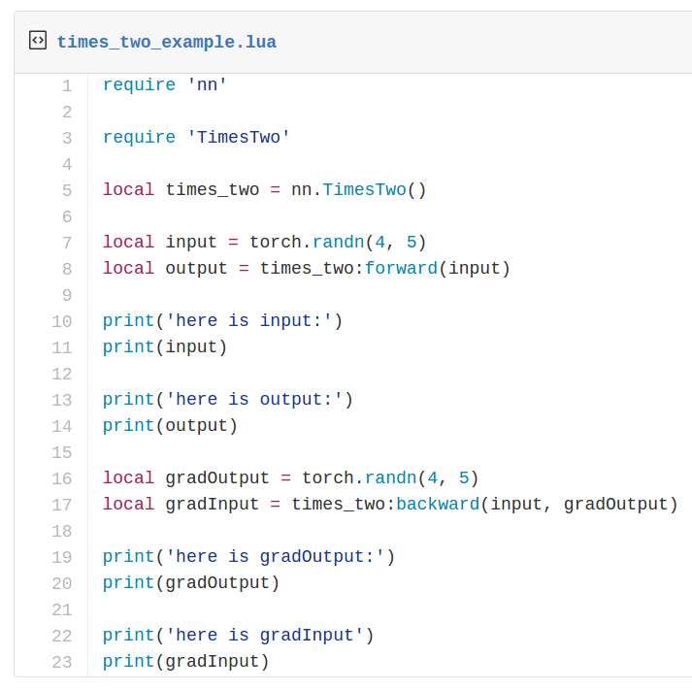
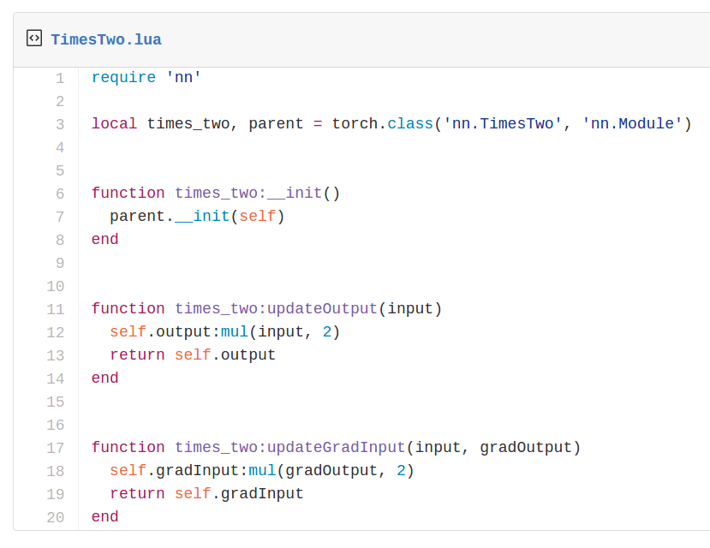
Torch: Modules
Writing your own modules is easy!

Slide 64
Torch: Modules
Container modules allow you to combine multiple modules

Slide 65
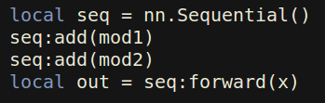
Torch: Modules
Container modules allow you to combine multiple modules
x
mod1
mod2
out

Slide 66
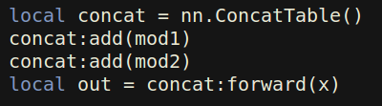
Torch: Modules
Container modules allow you to combine multiple modules
x
x
mod1
mod1
mod2
mod2
out
out[1]
out[2]

Slide 67
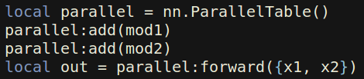
Torch: Modules
Container modules allow you to combine multiple modules
x
x
x1
x2
mod1
mod1
mod2
mod1
mod2
mod2
out[1]
out[2]
out[1]
out[2]
out

Slide 68
Torch: nngraph
Use nngraph to build modules that combine their inputs in complex ways
Inputs: x, y, z
Outputs: c
a = x + y
b = a ☉ z
c = a + b

Slide 69
Torch: nngraph
x
y
z
+
Use nngraph to build modules that combine their inputs in complex ways
a
☉
Inputs: x, y, z
Outputs: c
a = x + y
b = a ☉ z
c = a + b
b
+
c

Slide 70
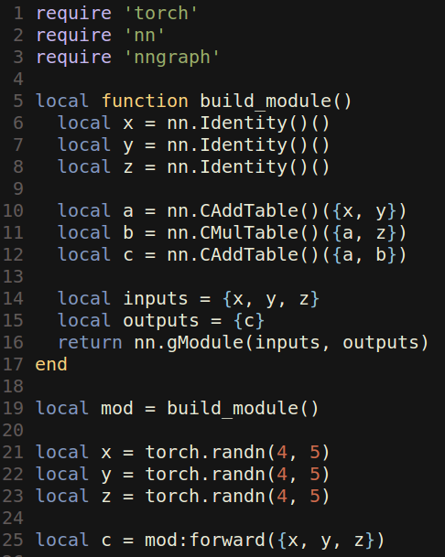
Torch: nngraph
x
y
z
+
Use nngraph to build modules that combine their inputs in complex ways
a
☉
Inputs: x, y, z
Outputs: c
a = x + y
b = a ☉ z
c = a + b
b
+
c

Slide 71
Torch: Pretrained Models
loadcaffe: Load pretrained Caffe models: AlexNet, VGG, some others https://github.com/szagoruyko/loadcaffe
GoogLeNet v1: https://github.com/soumith/inception.torch
GoogLeNet v3: https://github.com/Moodstocks/inception-v3.torch
ResNet: https://github.com/facebook/fb.resnet.torch

Slide 72
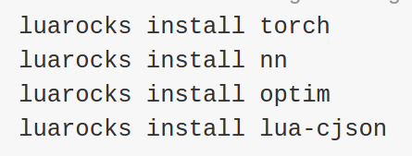
Torch: Package Management
After installing torch, use luarocks to install or update Lua packages
(Similar to pip install from Python)

Slide 73
Torch: Other useful packages
torch.cudnn: Bindings for NVIDIA cuDNN kernels https://github.com/soumith/cudnn.torch
torch-hdf5: Read and write HDF5 files from Torch https://github.com/deepmind/torch-hdf5
lua-cjson: Read and write JSON files from Lua https://luarocks.org/modules/luarocks/lua-cjson
cltorch, clnn: OpenCL backend for Torch, and port of nn https://github.com/hughperkins/cltorch, https://github.com/hughperkins/clnn
torch-autograd: Automatic differentiation; sort of like more powerful nngraph, similar to Theano or TensorFlow https://github.com/twitter/torch-autograd
fbcunn: Facebook: FFT conv, multi-GPU (DataParallel, ModelParallel) https://github.com/facebook/fbcunn

Slide 74
Torch: Typical Workflow
Step 1: Preprocess data; usually use a Python script to dump data to HDF5
Step 2: Train a model in Lua / Torch; read from HDF5 datafile, save trained model to disk
Step 3: Use trained model for something, often with an evaluation script

Slide 75
Torch: Typical Workflow
Example: https://github.com/jcjohnson/torch-rnn
Step 1: Preprocess data; usually use a Python script to dump data to HDF5 (https://github.com/jcjohnson/torch-rnn/blob/master/scripts/preprocess.py)
Step 2: Train a model in Lua / Torch; read from HDF5 datafile, save trained model to disk (https://github.com/jcjohnson/torch-rnn/blob/master/train.lua )
Step 3: Use trained model for something, often with an evaluation script (https://github.com/jcjohnson/torch-rnn/blob/master/sample.lua)

Slide 76
Torch: Pros / Cons
(-) Lua
(-) Less plug-and-play than Caffe
You usually write your own training code
(+) Lots of modular pieces that are easy to combine
(+) Easy to write your own layer types and run on GPU
(+) Most of the library code is in Lua, easy to read
(+) Lots of pretrained models!
(-) Not great for RNNs

Slide 77
Theano
http://deeplearning.net/software/theano/

Slide 78
Theano Overview
From Yoshua Bengio’s group at University of Montreal
Embracing computation graphs, symbolic computation
High-level wrappers: Keras, Lasagne

Slide 79
Theano: Computational Graphs
x
y
z
+
a
☉
b
+
c

Slide 80
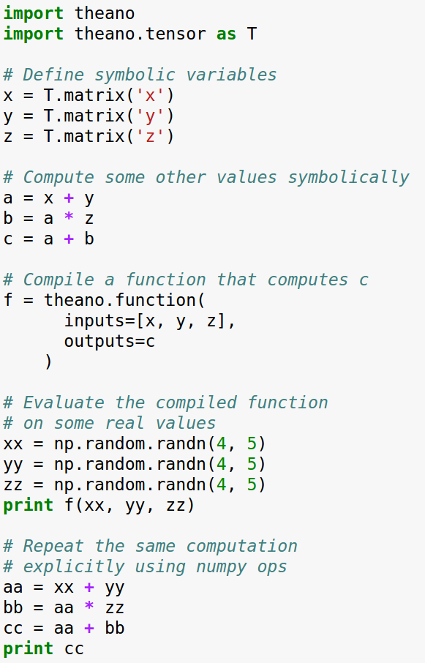
Theano: Computational Graphs
x
y
z
+
a
☉
b
+
c

Slide 81
Theano: Computational Graphs
x
y
z
Define symbolic variables;
these are inputs to the graph
+
a
☉
b
+
c

Slide 82
Theano: Computational Graphs
x
y
z
Compute intermediates and outputs symbolically
+
a
☉
b
+
c

Slide 83
Theano: Computational Graphs
x
y
z
Compile a function that produces c from x, y, z
(generates code)
+
a
☉
b
+
c

Slide 84
Theano: Computational Graphs
x
y
z
Run the function, passing some numpy arrays
(may run on GPU)
+
a
☉
b
+
c

Slide 85
Theano: Computational Graphs
x
y
z
Repeat the same computation using numpy operations (runs on CPU)
+
a
☉
b
+
c

Slide 86
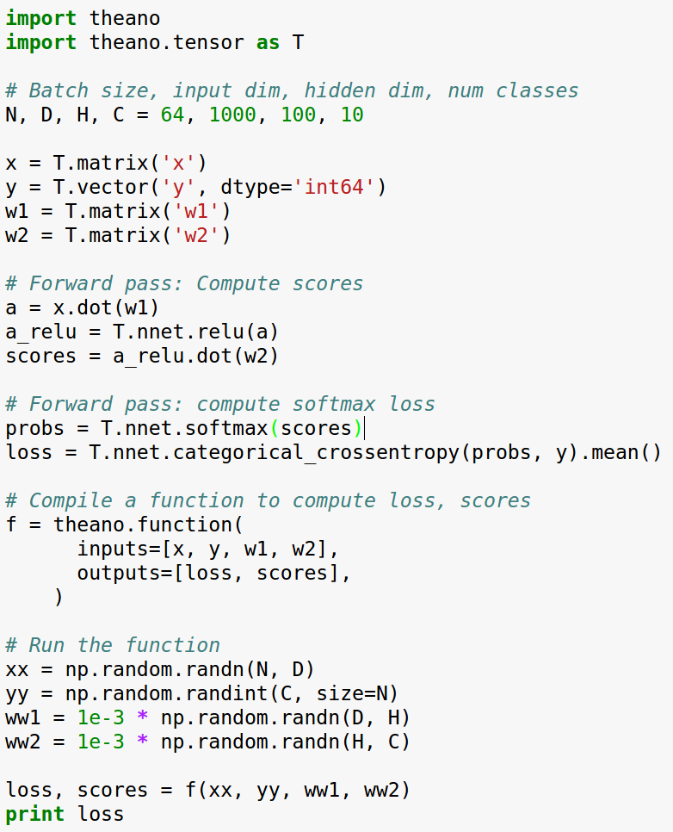
Theano: Simple Neural Net

Slide 87
Theano: Simple Neural Net
Define symbolic variables:
x = data
y = labels
w1 = first-layer weights
w2 = second-layer weights

Slide 88
Theano: Simple Neural Net
Forward: Compute scores (symbolically)

Slide 89
Theano: Simple Neural Net
Forward: Compute probs, loss (symbolically)

Slide 90
Theano: Simple Neural Net
Compile a function that computes loss, scores

Slide 91
Theano: Simple Neural Net
Stuff actual numpy arrays into the function

Slide 92
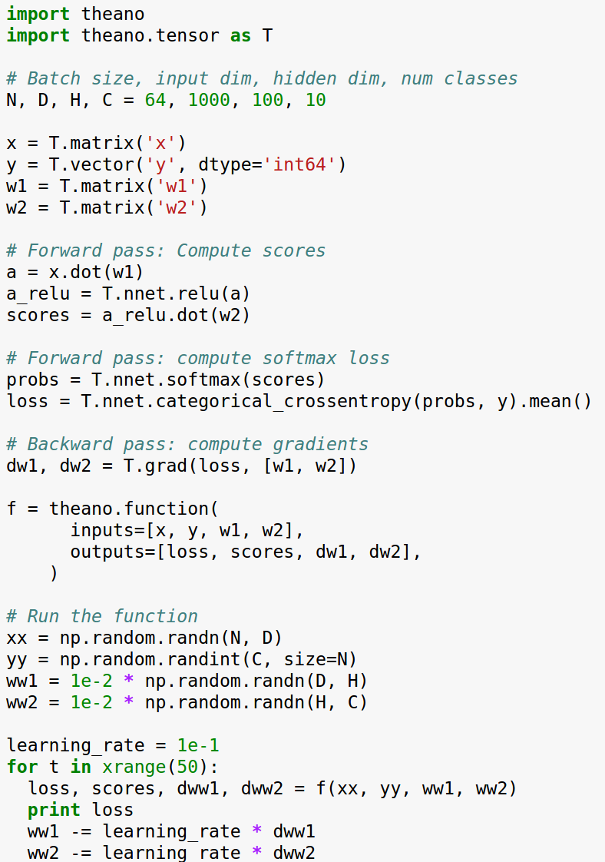
Theano: Computing Gradients

Slide 93
Theano: Computing Gradients
Same as before: define variables, compute scores and loss symbolically

Slide 94
Theano: Computing Gradients
Theano computes gradients for us symbolically!

Slide 95
Theano: Computing Gradients
Now the function returns loss, scores, and gradients

Slide 96
Theano: Computing Gradients
Use the function to perform gradient descent!

Slide 97
Theano: Computing Gradients
Problem: Shipping weights and gradients to CPU on every iteration to update...

Slide 98
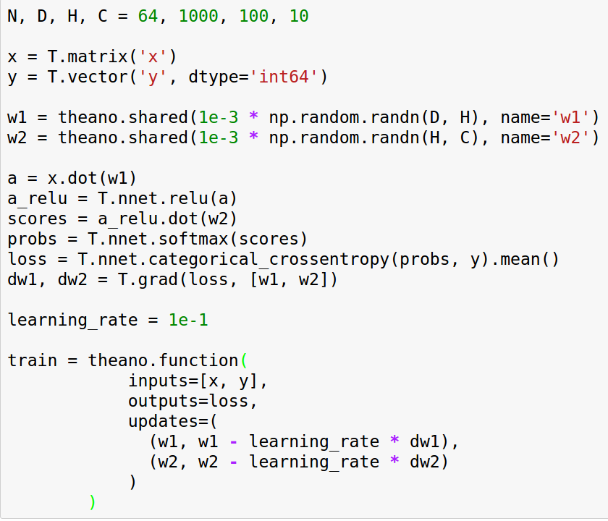
Theano: Shared Variables
Same as before: Define dimensions, define symbolic variables for x, y

Slide 99
Theano: Shared Variables
Define weights as shared variables that persist in the graph between calls; initialize with numpy arrays

Slide 100
Theano: Shared Variables
Same as before: Compute scores, loss, gradients symbolically

Slide 101
Theano: Shared Variables
Compiled function inputs are x and y; weights live in the graph

Slide 102
Theano: Shared Variables
Function includes an update that updates weights on every call

Slide 103
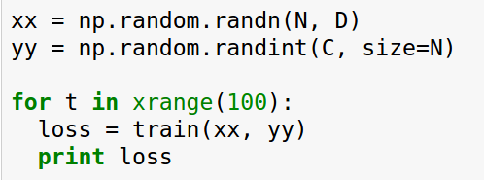
Theano: Shared Variables
To train the net, just call function repeatedly!

Slide 104
Theano: Other Topics
Conditionals: The ifelse and switch functions allow conditional control flow in the graph
Loops: The scan function allows for (some types) of loops in the computational graph; good for RNNs
Derivatives: Efficient Jacobian / vector products with R and L operators, symbolic hessians (gradient of gradient)
Sparse matrices, optimizations, etc

Slide 105
Theano: Multi-GPU
Experimental model parallelism:
http://deeplearning.net/software/theano/tutorial/using_multi_gpu.html
Data parallelism using platoon:
https://github.com/mila-udem/platoon

Slide 106
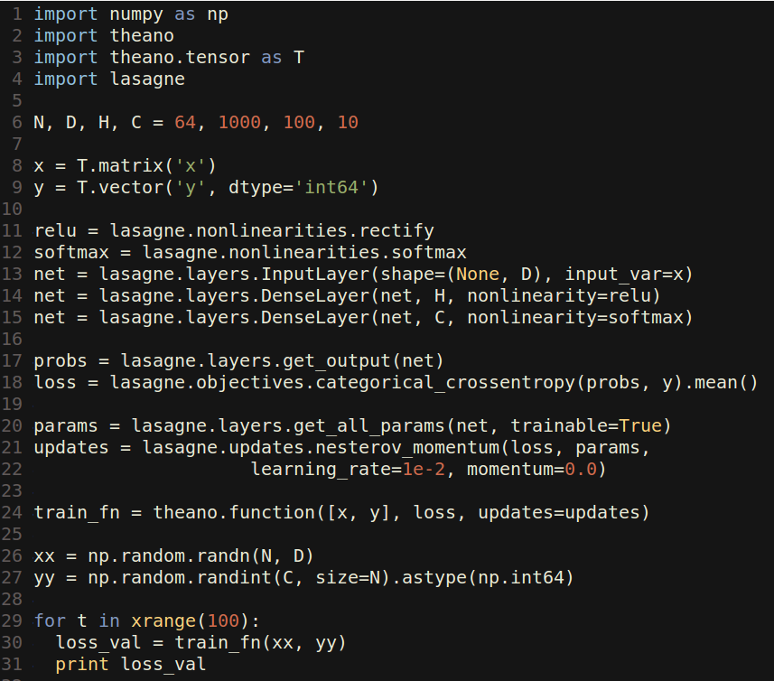
Lasagne: High Level Wrapper
Lasagne gives layer abstractions, sets up weights for you, writes update rules for you

Slide 107
Lasagne: High Level Wrapper
Set up symbolic Theano variables for data, labels

Slide 108
Lasagne: High Level Wrapper
Forward: Use Lasagne layers to set up layers; don’t set up weights explicitly

Slide 109
Lasagne: High Level Wrapper
Forward: Use Lasagne layers to compute loss

Slide 110
Lasagne: High Level Wrapper
Lasagne gets parameters, and writes the update rule for you

Slide 111
Lasagne: High Level Wrapper
Same as Theano: compile a function with updates, train model by calling function with arrays

Slide 112
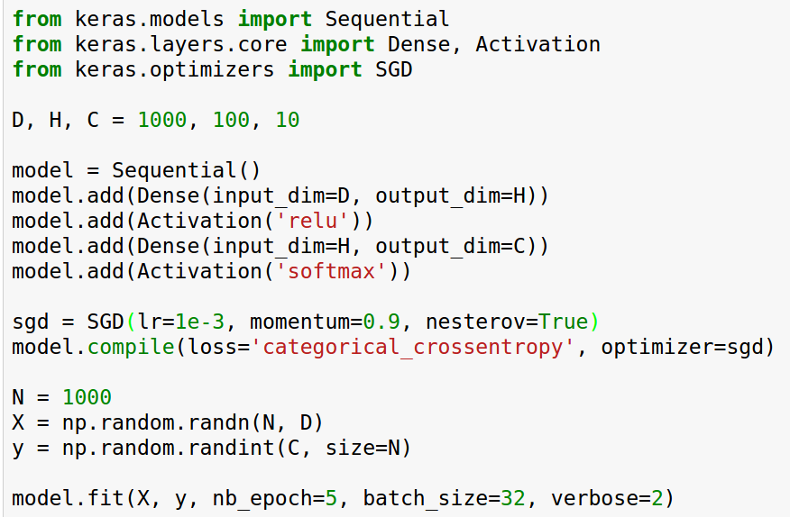
Keras: High level wrapper
keras is a layer on top of Theano; makes common things easy to do
(Also supports TensorFlow backend)

Slide 113
Keras: High level wrapper
keras is a layer on top of Theano; makes common things easy to do
Set up a two-layer ReLU net with softmax

Slide 114
Keras: High level wrapper
keras is a layer on top of Theano; makes common things easy to do
We will optimize the model using SGD with Nesterov momentum

Slide 115
Keras: High level wrapper
keras is a layer on top of Theano; makes common things easy to do
Generate some random data and train the model

Slide 116
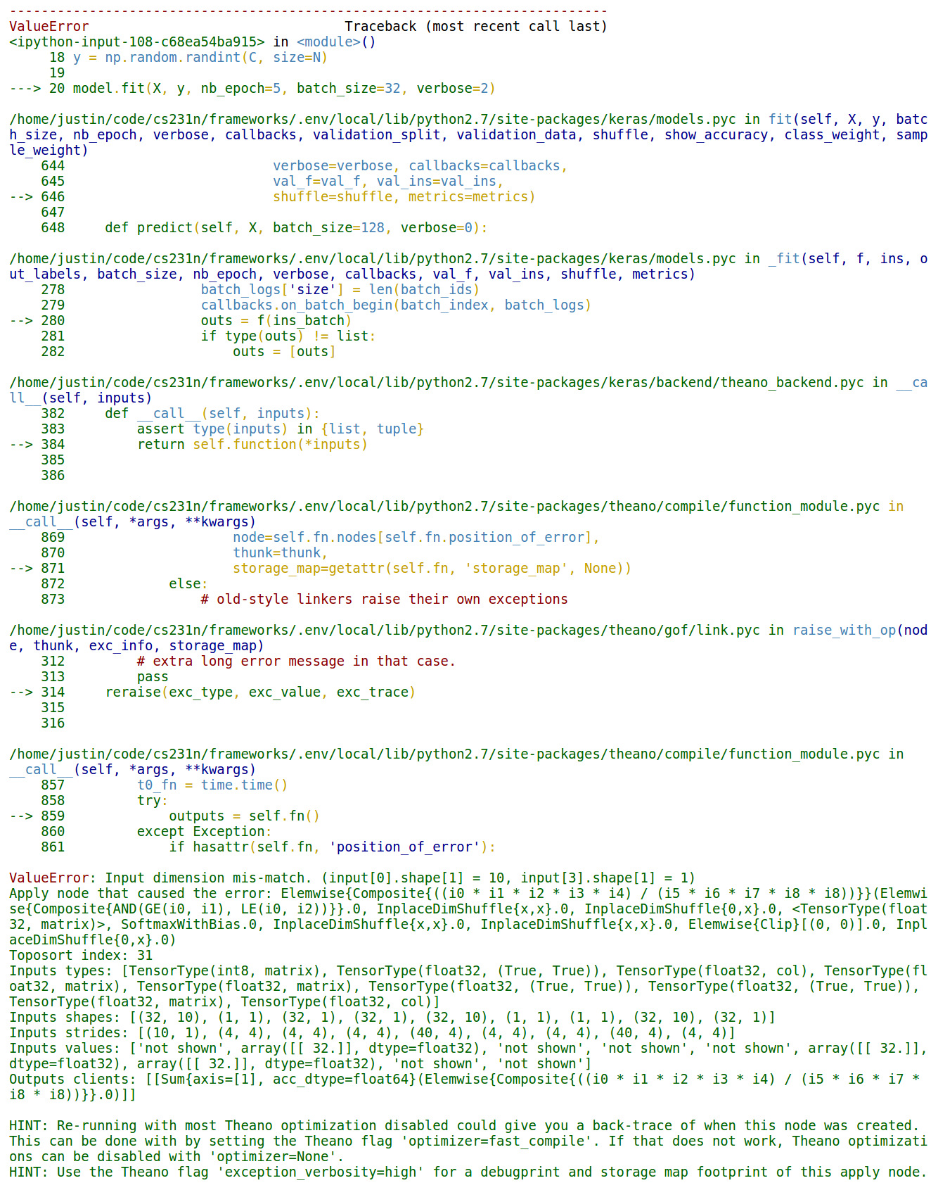
Keras: High level wrapper
Problem: It crashes, stack trace and error message not useful :(
Notes:
Input dimension mis-match. (input[0].shape[1] = 10, input[3].shape[1] = 1) Apply node that caused the error: Elemwise{Composite{((i0 * i1 * i2 * i3 * i4) / (i5 * i6 * i7 * i8 * i8))}}(Elemwise{Composite{AND(GE(i0, i1), LE(i0, i2))}}.0, InplaceDimShuffle{x,x}.0, InplaceDimShuffle{0,x}.0, <TensorType(float32, matrix)>, SoftmaxWithBias.0, InplaceDimShuffle{x,x}.0, InplaceDimShuffle{x,x}.0, Elemwise{Clip}[(0, 0)].0, InplaceDimShuffle{0,x}.0) Toposort index: 31 Inputs types: [TensorType(int8, matrix), TensorType(float32, (True, True)), TensorType(float32, col), TensorType(float32, matrix), TensorType(float32, matrix), TensorType(float32, (True, True)), TensorType(float32, (True, True)), TensorType(float32, matrix), TensorType(float32, col)] Inputs shapes: [(32, 10), (1, 1), (32, 1), (32, 1), (32, 10), (1, 1), (1, 1), (32, 10), (32, 1)] Inputs strides: [(10, 1), (4, 4), (4, 4), (4, 4), (40, 4), (4, 4), (4, 4), (40, 4), (4, 4)] Inputs values: ['not shown', array([[ 32.]], dtype=float32), 'not shown', 'not shown', 'not shown', array([[ 32.]], dtype=float32), array([[ 32.]], dtype=float32), 'not shown', 'not shown'] Outputs clients: [[Sum{axis=[1], acc_dtype=float64}(Elemwise{Composite{((i0 * i1 * i2 * i3 * i4) / (i5 * i6 * i7 * i8 * i8))}}.0)]] HINT: Re-running with most Theano optimization disabled could give you a back-trace of when this node was created. This can be done with by setting the Theano flag 'optimizer=fast_compile'. If that does not work, Theano optimizations can be disabled with 'optimizer=None'. HINT: Use the Theano flag 'exception_verbosity=high' for a debugprint and storage map footprint of this apply node.

Slide 117
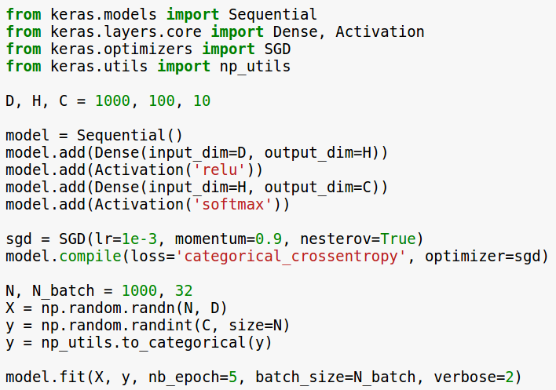
Keras: High level wrapper
Solution: y should be one-hot
(too much API for me … )
Notes:
Input dimension mis-match. (input[0].shape[1] = 10, input[3].shape[1] = 1) Apply node that caused the error: Elemwise{Composite{((i0 * i1 * i2 * i3 * i4) / (i5 * i6 * i7 * i8 * i8))}}(Elemwise{Composite{AND(GE(i0, i1), LE(i0, i2))}}.0, InplaceDimShuffle{x,x}.0, InplaceDimShuffle{0,x}.0, <TensorType(float32, matrix)>, SoftmaxWithBias.0, InplaceDimShuffle{x,x}.0, InplaceDimShuffle{x,x}.0, Elemwise{Clip}[(0, 0)].0, InplaceDimShuffle{0,x}.0) Toposort index: 31 Inputs types: [TensorType(int8, matrix), TensorType(float32, (True, True)), TensorType(float32, col), TensorType(float32, matrix), TensorType(float32, matrix), TensorType(float32, (True, True)), TensorType(float32, (True, True)), TensorType(float32, matrix), TensorType(float32, col)] Inputs shapes: [(32, 10), (1, 1), (32, 1), (32, 1), (32, 10), (1, 1), (1, 1), (32, 10), (32, 1)] Inputs strides: [(10, 1), (4, 4), (4, 4), (4, 4), (40, 4), (4, 4), (4, 4), (40, 4), (4, 4)] Inputs values: ['not shown', array([[ 32.]], dtype=float32), 'not shown', 'not shown', 'not shown', array([[ 32.]], dtype=float32), array([[ 32.]], dtype=float32), 'not shown', 'not shown'] Outputs clients: [[Sum{axis=[1], acc_dtype=float64}(Elemwise{Composite{((i0 * i1 * i2 * i3 * i4) / (i5 * i6 * i7 * i8 * i8))}}.0)]] HINT: Re-running with most Theano optimization disabled could give you a back-trace of when this node was created. This can be done with by setting the Theano flag 'optimizer=fast_compile'. If that does not work, Theano optimizations can be disabled with 'optimizer=None'. HINT: Use the Theano flag 'exception_verbosity=high' for a debugprint and storage map footprint of this apply node.

Slide 118
Theano: Pretrained Models
Lasagne Model Zoo has pretrained common architectures:
https://github.com/Lasagne/Recipes/tree/master/modelzoo
AlexNet with weights: https://github.com/uoguelph-mlrg/theano_alexnet
sklearn-theano: Run OverFeat and GoogLeNet forward, but no fine-tuning? http://sklearn-theano.github.io
caffe-theano-conversion: CS 231n project from last year: load models and weights from caffe! Not sure if full-featured https://github.com/kitofans/caffe-theano-conversion

Slide 119
Theano: Pretrained Models
Best choice
Lasagne Model Zoo has pretrained common architectures:
https://github.com/Lasagne/Recipes/tree/master/modelzoo
AlexNet with weights: https://github.com/uoguelph-mlrg/theano_alexnet
sklearn-theano: Run OverFeat and GoogLeNet forward, but no fine-tuning? http://sklearn-theano.github.io
caffe-theano-conversion: CS 231n project from last year: load models and weights from caffe! Not sure if full-featured https://github.com/kitofans/caffe-theano-conversion

Slide 120
Theano: Pros / Cons
(+) Python + numpy
(+) Computational graph is nice abstraction
(+) RNNs fit nicely in computational graph
(-) Raw Theano is somewhat low-level
(+) High level wrappers (Keras, Lasagne) ease the pain
(-) Error messages can be unhelpful
(-) Large models can have long compile times
(-) Much “fatter” than Torch; more magic
(-) Patchy support for pretrained models

Slide 121
TensorFlow
https://www.tensorflow.org

Slide 122
TensorFlow
From Google
Very similar to Theano - all about computation graphs
Easy visualizations (TensorBoard)
Multi-GPU and multi-node training

Slide 123
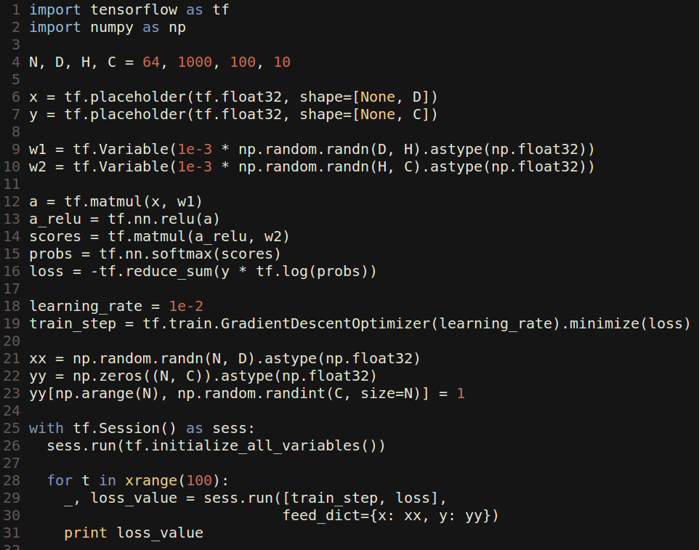
TensorFlow: Two-Layer Net

Slide 124
TensorFlow: Two-Layer Net
Create placeholders for data and labels: These will be fed to the graph

Slide 125
TensorFlow: Two-Layer Net
Create Variables to hold weights; similar to Theano shared variables
Initialize variables with numpy arrays

Slide 126
TensorFlow: Two-Layer Net
Forward: Compute scores, probs, loss (symbolically)

Slide 127
TensorFlow: Two-Layer Net
Running train_step will use SGD to minimize loss

Slide 128
TensorFlow: Two-Layer Net
Create an artificial dataset; y is one-hot like Keras

Slide 129
TensorFlow: Two-Layer Net
Actually train the model

Slide 130
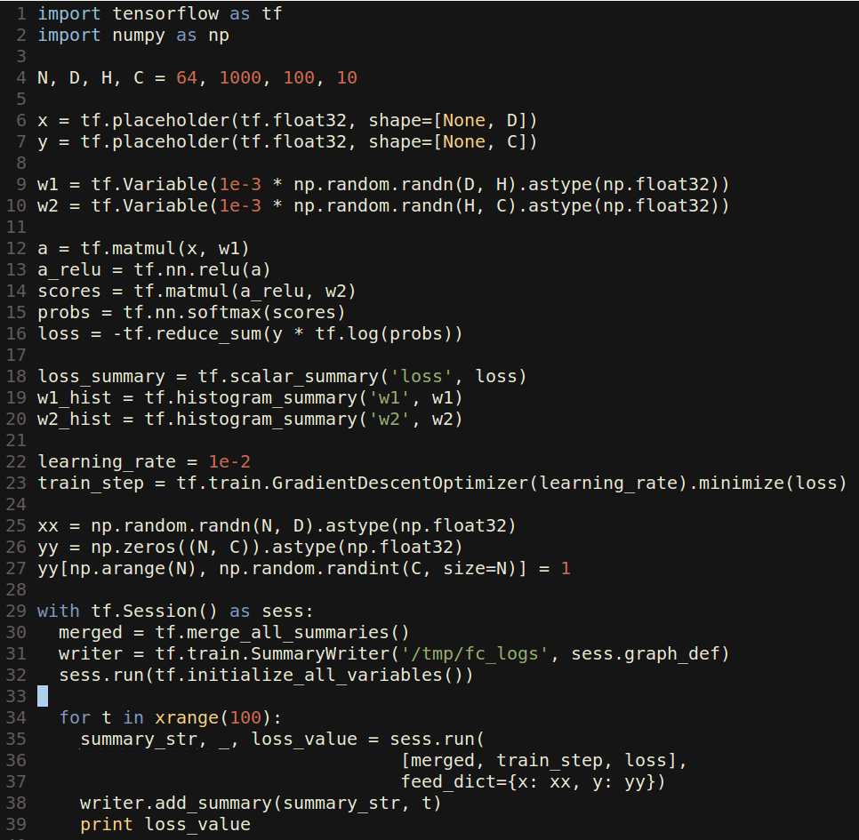
TensorFlow: Tensorboard
Tensorboard makes it easy to visualize what’s happening inside your models

Slide 131
TensorFlow: Tensorboard
Tensorboard makes it easy to visualize what’s happening inside your models
Same as before, but now we create summaries for loss and weights

Slide 132
TensorFlow: Tensorboard
Tensorboard makes it easy to visualize what’s happening inside your models
Create a special “merged” variable and a SummaryWriter object

Slide 133
TensorFlow: Tensorboard
Tensorboard makes it easy to visualize what’s happening inside your models
In the training loop, also run merged and pass its value to the writer

Slide 134
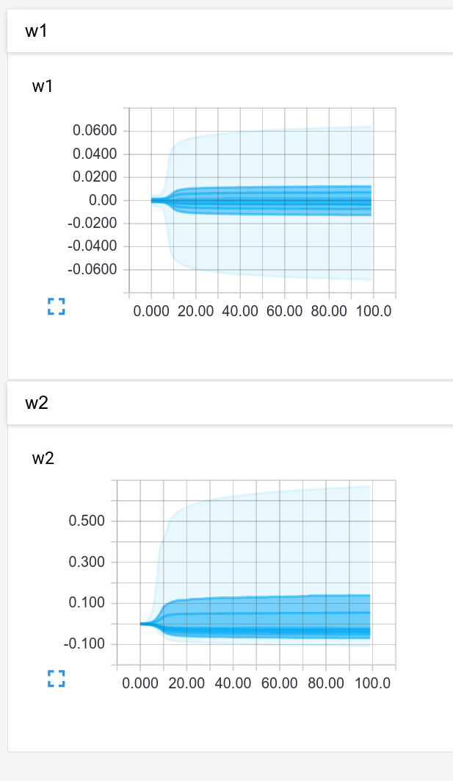
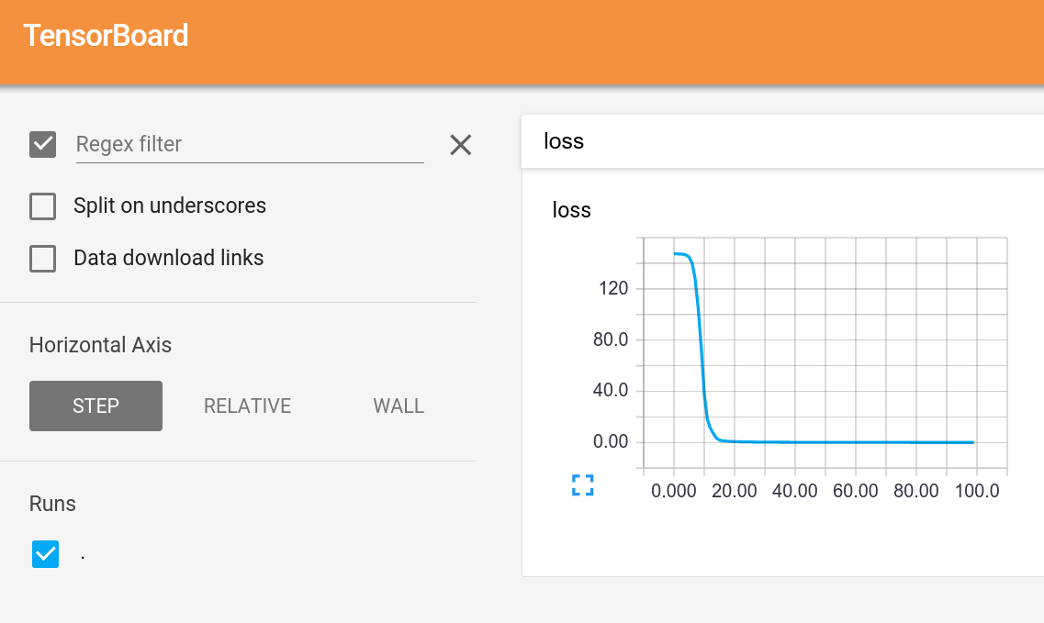
TensorFlow: Tensorboard
Start Tensorboard server, and we get graphs!

Slide 135

TensorFlow: TensorBoard

Slide 136
TensorFlow: TensorBoard
Add names to placeholders and variables

Slide 137
TensorFlow: TensorBoard
Add names to placeholders and variables
Break up the forward pass with name scoping

Slide 138

TensorFlow: TensorBoard
Tensorboard shows the graph!

Slide 139

TensorFlow: TensorBoard
Tensorboard shows the graph!
Name scopes expand to show individual operations

Slide 140

TensorFlow: Multi-GPU
Data parallelism: synchronous or asynchronous

Slide 141

TensorFlow: Multi-GPU
Data parallelism: synchronous or asynchronous
Model parallelism: Split model across GPUs

Slide 142

TensorFlow: Distributed
Single machine:
Like other frameworks
Many machines:
Not open source (yet) =(

Slide 143
TensorFlow: Pretrained Models
You can get a pretrained version of Inception here:
https://github.com/tensorflow/tensorflow/blob/master/tensorflow/examples/android/README.md
(In an Android example?? Very well-hidden)
The only one I could find =(

Slide 144
TensorFlow: Pros / Cons
(+) Python + numpy
(+) Computational graph abstraction, like Theano; great for RNNs
(+) Much faster compile times than Theano
(+) Slightly more convenient than raw Theano?
(+) TensorBoard for visualization
(+) Data AND model parallelism; best of all frameworks
(+/-) Distributed models, but not open-source yet
(-) Slower than other frameworks right now
(-) Much “fatter” than Torch; more magic
(-) Not many pretrained models

Slide 145
Overview
 | Caffe | Torch | Theano | TensorFlow
Language | C++, Python | Lua | Python | Python
Pretrained | Yes ++ | Yes ++ | Yes (Lasagne) | Inception
Multi-GPU: Data parallel | Yes | Yes cunn.DataParallelTable | Yes platoon | Yes
Multi-GPU: Model parallel | No | Yes fbcunn.ModelParallel | Experimental | Yes (best)
Readable source code | Yes (C++) | Yes (Lua) | No | No
Good at RNN | No | Mediocre | Yes | Yes (best)

Slide 146
Use Cases
Extract AlexNet or VGG features?

Slide 147
Use Cases
Extract AlexNet or VGG features? Use Caffe

Slide 148
Use Cases
Fine-tune AlexNet for new classes?

Slide 149
Use Cases
Fine-tune AlexNet for new classes? Use Caffe

Slide 150
Use Cases
Image Captioning with finetuning?

Slide 151
Use Cases
Image Captioning with finetuning?
-> Need pretrained models (Caffe, Torch, Lasagne)
-> Need RNNs (Torch or Lasagne)
-> Use Torch or Lasagna

Slide 152
Use Cases
Segmentation? (Classify every pixel)

Slide 153
Use Cases
Segmentation? (Classify every pixel)
-> Need pretrained model (Caffe, Torch, Lasagna)
-> Need funny loss function
-> If loss function exists in Caffe: Use Caffe
-> If you want to write your own loss: Use Torch

Slide 154
Use Cases
Object Detection?

Slide 155
Use Cases
Object Detection?
-> Need pretrained model (Torch, Caffe, Lasagne)
-> Need lots of custom imperative code (NOT Lasagne)
-> Use Caffe + Python or Torch

Slide 156
Use Cases
Language modeling with new RNN structure?

Slide 157
Use Cases
Language modeling with new RNN structure?
-> Need easy recurrent nets (NOT Caffe, Torch)
-> No need for pretrained models
-> Use Theano or TensorFlow

Slide 158
Use Cases
Implement BatchNorm?
-> Don’t want to derive gradient? Theano or TensorFlow
-> Implement efficient backward pass? Use Torch

Slide 159
My Recommendation
Feature extraction / finetuning existing models: Use Caffe
Complex uses of pretrained models: Use Lasagne or Torch
Write your own layers: Use Torch
Crazy RNNs: Use Theano or Tensorflow
Huge model, need model parallelism: Use TensorFlow

Slide 162



Caffe: Blobs
https://github.com/BVLC/caffe/blob/master/include/caffe/blob.hpp

Slide 163
Caffe: Blobs
N-dimensional array for storing activations and weights
https://github.com/BVLC/caffe/blob/master/include/caffe/blob.hpp

Slide 164
Caffe: Blobs
N-dimensional array for storing activations and weights
Template over datatype
https://github.com/BVLC/caffe/blob/master/include/caffe/blob.hpp

Slide 165
Caffe: Blobs
N-dimensional array for storing activations and weights
Template over datatype
Two parallel tensors:
data: values
diffs: gradients
https://github.com/BVLC/caffe/blob/master/include/caffe/blob.hpp

Slide 166
Caffe: Blobs
N-dimensional array for storing activations and weights
Template over datatype
Two parallel tensors:
data: values
diffs: gradients
Stores CPU / GPU versions of each tensor
https://github.com/BVLC/caffe/blob/master/include/caffe/blob.hpp

Slide 167


Caffe: Layer
A small unit of computation
https://github.com/BVLC/caffe/blob/master/include/caffe/layer.hpp

Slide 168
Caffe: Layer
A small unit of computation
Forward: Use “bottom” data to compute “top” data
https://github.com/BVLC/caffe/blob/master/include/caffe/layer.hpp

Slide 169
Caffe: Layer
A small unit of computation
Forward: Use “bottom” data to compute “top” data
Backward: Use “top” diffs to compute “bottom” diffs
https://github.com/BVLC/caffe/blob/master/include/caffe/layer.hpp

Slide 170
Caffe: Layer
A small unit of computation
Forward: Use “bottom” data to compute “top” data
Backward: Use “top” diffs to compute “bottom” diffs
Separate CPU / GPU implementations
https://github.com/BVLC/caffe/blob/master/include/caffe/layer.hpp
Notes:
CPU implementations pure virtual; GPU implementations default to use CPU

Slide 171

Caffe: Layer
Tons of different layer types:
...
https://github.com/BVLC/caffe/tree/master/src/caffe/layers
Notes:
CPU implementations pure virtual; GPU implementations default to use CPU

Slide 172
Caffe: Layer
Tons of different layer types:
batch norm
convolution
cuDNN convolution
.cpp: CPU implementation
.cu: GPU implementation
...
https://github.com/BVLC/caffe/tree/master/src/caffe/layers
Notes:
CPU implementations pure virtual; GPU implementations default to use CPU

Slide 173



Caffe: Net
Collects layers into a DAG
Run all or part of the net forward and backward
https://github.com/BVLC/caffe/blob/master/include/caffe/net.hpp

Slide 174

Caffe: Solver
https://github.com/BVLC/caffe/blob/master/include/caffe/solver.hpp

Slide 175
Caffe: Solver
Trains a Net by running it forward / backward, updating weights
https://github.com/BVLC/caffe/blob/master/include/caffe/solver.hpp

Slide 176
Caffe: Solver
Trains a Net by running it forward / backward, updating weights
Handles snapshotting, restoring from snapshots
https://github.com/BVLC/caffe/blob/master/include/caffe/solver.hpp

Slide 177



Caffe: Solver
Trains a Net by running it forward / backward, updating weights
Handles snapshotting, restoring from snapshots
Subclasses implement different update rules
https://github.com/BVLC/caffe/blob/master/include/caffe/sgd_solvers.hpp

